Slide 1

Operating System Security (CYS337)
Write Protected USB Drive| CMD
By James Soko (20231392)
2nd September, 2025

Slide 2
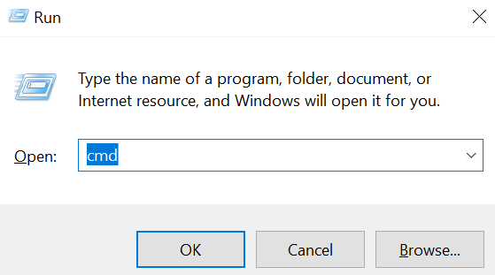
Command Prompt
Press Windows + R and type cmd and click on OK
Insert the target USB Drive

Slide 3


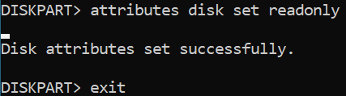
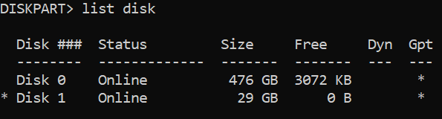
Read-only
Enter the following commands on CMD
diskpart
list disk
select disk 1
attributes volume set readonly

Slide 4

Remove Read-only Protection
Enter the following commands on CMD
diskpart
list disk
select disk 1
attributes volume clear readonly

